Slide 1
The governmental structure for Swedish civil defence

Slide 2

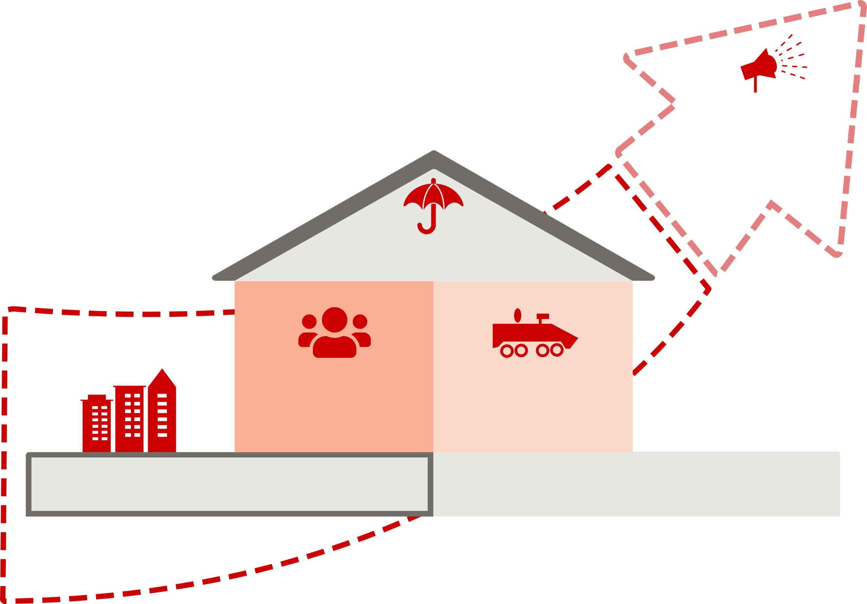
EMERGENCY PREPAREDNESS, CIVIL DEFENCE AND TOTAL DEFENCE
Civil preparedness
Heightened state of alert
Total defence
Emergency preparedness
Civil defence
Military defence
Civil preparedness
Notes:
Civil preparedness includes both emergency preparedness and civil defence, which reinforce each other through joint coordination, planning and preparation.
The level of crisis determines the scope of civil preparedness. Civil defence encompasses the whole of society, and many actors must collaborate in order to achieve the civil defence objectives, i.e. the capability to protect the population, safeguard the most important societal functions, maintain necessary supplies and contribute to the military defence in the event of an armed attack or war. A modern civil defence goes side by side with military defence contributing and strengthening the total defence.
Total defence are the measures needed to prepare society in case of an armed attack and war. The government can decide on a state of heightened alert to strengthen the country’s defence capabilities. There are two levels of heightened alert, ‘high alert’ and ‘highest alert’. Highest alert prevails if Sweden is at war. Under the highest state of alert, total defence covers all of society’s activities that must be carried out. Total defence includes military activities (military defence) and civilian activities (civil defence). This includes protection of the population, security of supply and psychological defence.

Slide 3
The goal for the civil defence shall be to have the capability to:
Civil preparedness
safeguard the most essential public services;
contribute to the military defence’s capability within the framework of NATO’s collective defence and other duties;
protect the civilian population; and
maintain Sweden’s will to defend itself and society’s resilience to external pressure.
Notes:
Civil defence includes all of the contingency preparations made by civilian actors in peacetime and required in the event of war. Civil defence includes command structures, the supply of energy, food (including drinking water) and electronic communications, as well as transport, financial services and health care for the needs of the population and of total defence. Many different actors are responsible for these activities: government agencies, municipalities, regions, businesses and voluntary organisations. The general public has an essential role to play.
Numerous stakeholders must cooperate and work together to achieve the objectives of civil defence: XYZ

Slide 4
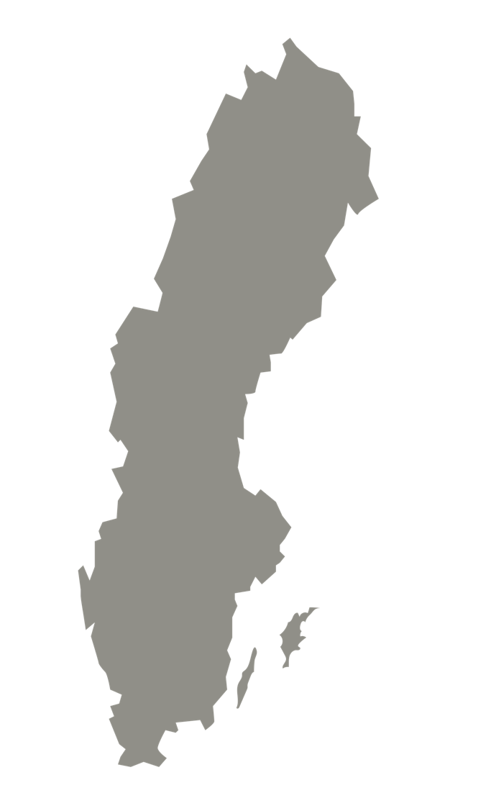
CIVILIAN ACTORS
Civil preparedness
Parliament and Government
Government agencies
The County Administrative Boards
Civil preparedness covers the whole of society, and requires the collaboration of many actors, government agencies, municipalities, regions, industry and NGOs.
Everyone who lives in Sweden shares a collective responsibility for our country's security and safety.
Regions
Municipalities
Trade and industry
Voluntary organisations
Individuals
Notes:
Civil preparedness covers the whole of society, and requires the collaboration of many actors government agencies, municipalities, regions, industry and NGOs.
Everyone who lives in Sweden shares a collective responsibility for our country's security and safety.

Slide 5
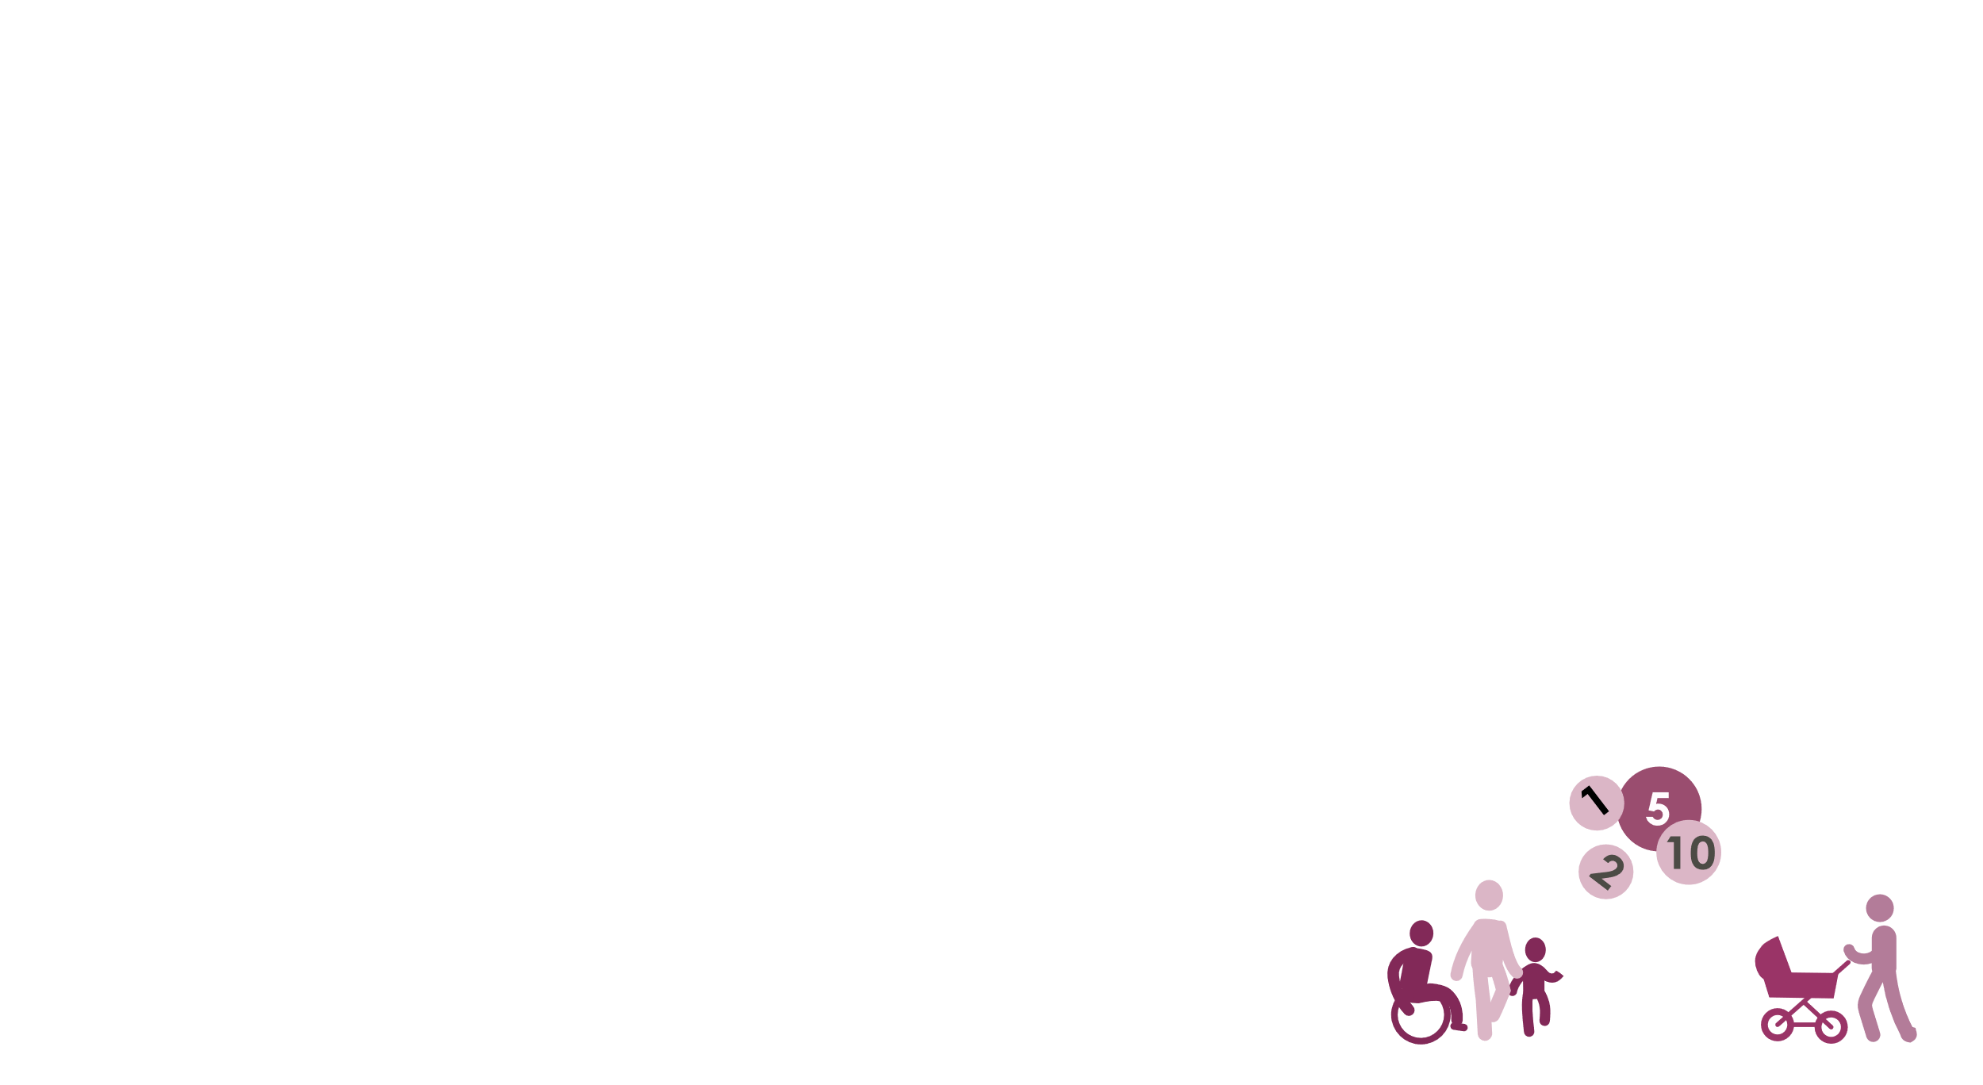





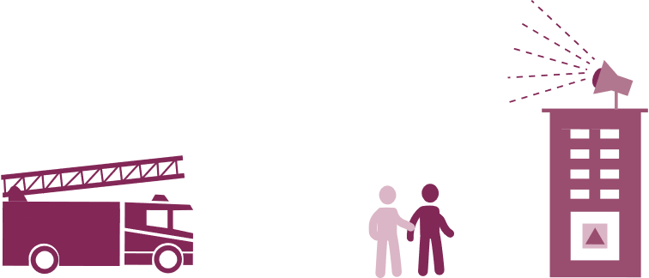

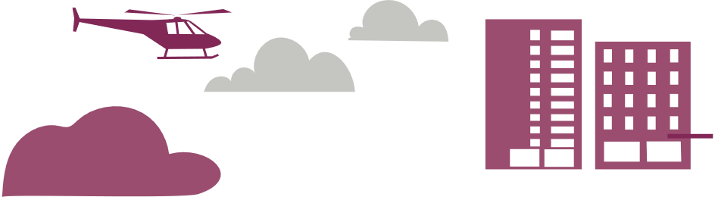

10 CIVIL PREPAREDNESS SECTORS
ECONOMIC SECURITY
ELECTRONIC COMMUNICATIONS AND POSTAL SERVICES
ENERGY SUPPLY
FINANCIAL SERVICES
BASIC DATA
The Swedish Social Insurance Agency
The Swedish Post and
Telecom Authority
The Swedish Energy Agency
The Swedish Financial
Supervisory Authority
The Swedish Tax Agency
The Swedish Public Employment Service
The Swedish Pensions Agency
The Swedish National Debt Office
The Swedish Tax Agency
The National Government
Service Centre
Swedish Payments Agency
The Swedish Civil Contingencies Agency
Swedish National Grid
The Swedish Transport Administration
The Swedish Energy Markets Inspectorate
The Swedish Radiation Safety Authority
Swedish National Grid
The Swedish National Debt Office
Sveriges Riksbank*
The Swedish Companies Registration Office
The Land Survey
The Agency for Digital Government
HEALTH, MEDICAL CARE
AND WELFARE
FOOD SUPPLY AND
DRINKING WATER
PUBLIC ORDER AND SECURITY
CIVIL PROTECTION
TRANSPORT
The National Board of
Health and Welfare
The Swedish Food Agency
The Swedish Police Authority
The Swedish Civil
Contingencies Agency
The Swedish Transport Administration
The Swedish eHealth Agency
The Public Health Agency
of Sweden
The Swedish Medical Products Agency
The Swedish Board of Agriculture
The County Administrative Boards
The Swedish Environmental Protection Agency
The National Veterinary Institute
The Swedish Prison and Probation Service
The Swedish Coast Guard
The Security Service
The Swedish Customs
The Swedish Prosecution Authority
The Swedish National Courts Administration
The Swedish Coast Guard
The County Administrative Boards
The Swedish Police Authority
The Swedish Maritime Administration
The Swedish Meteorological and Hydrological Institute
The Swedish Radiation Safety Authority
Air Navigation Services of Sweden
The Swedish Maritime Administration
The Swedish Transport Agency
Within each sector, there is an agency with sectoral responsibilities for civil preparedness. This involves developing civil preparedness within the sector, supporting the national civil preparedness agencies and ensuring coordination and cooperation with other relevant actors.
*Sveriges riksbank, Sweden´s central bank is not formally part of the sector, but participates as an authority under the Parliament.
Notes:
The structural reform for civil preparedness identifies 10 civil preparedness sectors, 60 agencies with specific responsibilities for civil preparedness and 6 civil defence regions at a higher regional level.
Within each sector, there is an agency with sectoral responsibilities for civil preparedness. This involves developing civil preparedness within the sector, supporting the national civil preparedness agencies and ensuring coordination and cooperation with other relevant actors.
The Swedish Civil Contingencies Agency (MSB) is responsible for ensuring that civil preparedness planning is on all administrative levels, national, regional and local. MSB and the Armed Forces are together responsible for a coherent total defence planning.
The 10 civil preparedness sectors are Economic security, Electronic communications and postal services, Energy supply, Financial services, Basic data, Health, medical care and welfare, Food supply and drinking water, Public order and security, Transport and Civil protection. MSB is responsible for the Civil protection sector.

Slide 6

OTHER IMPORTANT SOCIETAL FUNCTIONS
Civil preparedness
OTHER IMPORTANT AREAS FOR CIVIL PREPAREDNESS
Cyber security
Psychological defence
Schools and preschool
Migration
Notes:
There are other important areas for civil preparedness, which are not, formally identified as sectors. These support the civil preparedness work and are;
Psychological defence – creates conditions for safeguarding an open and democratic society, free expression of opnion and Sweden´s freedom and independence as well as ensuring the people´s willingness to defend.
Compulsary school and preschool
Migration

Slide 7
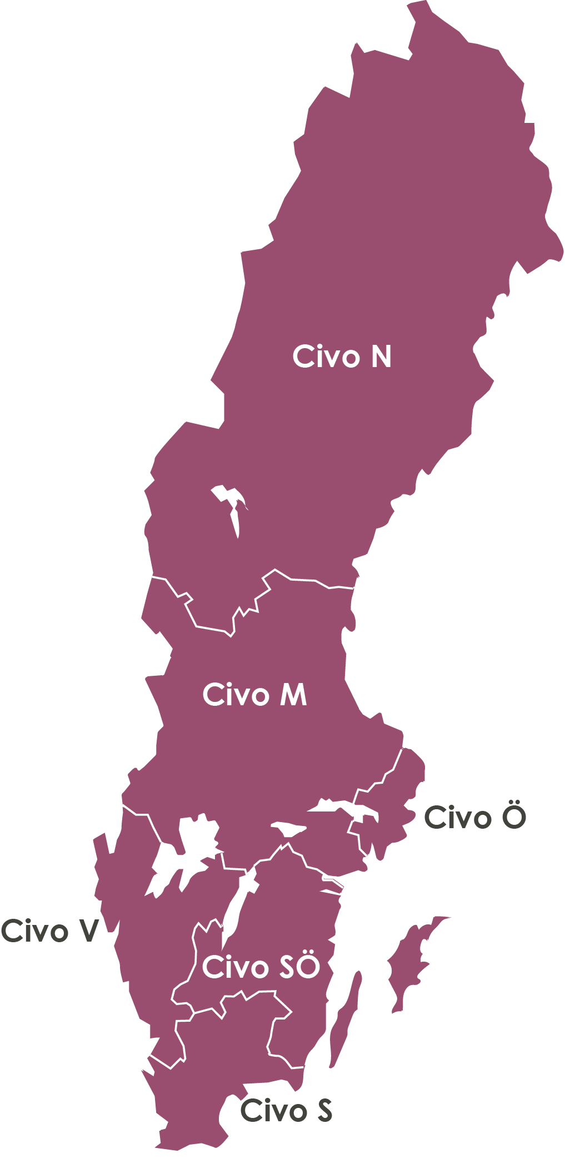





SIX CIVIL DEFENCE REGIONS
CIVIL DEFENCE REGION NORTH Västernorrland, Jämtland, Västerbotten and Norrbotten RESPONSIBLE COUNTY ADMINISTRATIVE BOARD Norrbotten County Administrative Board
CIVIL DEFENCE REGION MIDDLE
Uppsala, Södermanland, Västmanland, Värmland, Örebro, Dalarna och Gävleborg RESPONSIBLE COUNTY ADMINISTRATIVE BOARD
Örebro County Administrative Board
CIVIL DEFENCE REGION WEST
Halland and Västra Götaland
RESPONSIBLE COUNTY ADMINISTRATIVE BOARD
Västra Götaland County Administrative Board
CIVIL DEFENCE REGION EAST Stockholm and Gotland
RESPONSIBLE COUNTY ADMINISTRATIVE BOARD
Stockholm County Administrative Board
CIVIL DEFENCE REGION SOUTHEAST
Jönköping, Kalmar and
Östergötland
RESPONSIBLE COUNTY ADMINISTRATIVE BOARD Östergötland County Administrative Board
CIVIL DEFENCE REGION SOUTH Kronoberg, Blekinge and Skåne
RESPONSIBLE COUNTY ADMINISTRATIVE BOARD
Skåne County Administrative Board
Notes:
As mentioned before, the structural reform for civil preparedness also introduces 6 civil defence regions at a higher regional level.
One County Administrative Board in each of the six regions has added responsibilities for civil defence and coordination with the military defence.
Extra information;
Sweden is divided into 21 counties. Political tasks at this level are undertaken on the one hand by the regional councils, whose decision-makers are directly elected by the people of the county and, on the other, by the county administrative boards which are government bodies in the counties (coordinate regional preparedness work and to conduct risk and vulnerability assessments, among others). Some public authorities also operate at regional and local levels, for example through county boards.

